Slide 1


BitGate Language Design And Implementation
Student Name: Alexanter Baso
Student ID: 100533316
Module Leader: Sotirios Chronopoulos

Slide 2

BitGate Language Computational Model
BitGate is a general-purpose language and consists of a “mix” of imperative and object-oriented language. The thought behind this is that: the user must give commands into a class that the computer must strictly follow, such as, declare a variable x, do a during function, write into the screen or do a weather function.

Slide 3

BitGate Language Paradigm
BitGate implements a “mix” of imperative paradigm and of an object-oriented paradigm. This means that the commands given by the user will be specific into a class and the computer will follow them in order. All of these must be commands that the computer understands, such as "INTEGER _firstInteger = 6;".

Slide 4

BitGate Language Type
The type of BitGate language is a “mix” of Object-Oriented Language, Functional Language and of an Algorithmic Language. The functions, “Headfunc” function, “Whether-Otherwise” and “During-Do” are based on code blocks and all those must be into a class.

Slide 5

Is BitGate Unique?
The BitGate language is very easy to use and is unique because it can implement programs that are related to all logical expressions which are related to Binary system, Octal system, Hexadecimal system. For example, the user can write as command "0b11100 NAND 0b10011" or "0o231 OR 0o532" or "0xDAD XOR 0xABC" and can also do mathematical operations without symbols. For example, "5 MULTIPLY 7" or "15 DIVIDE 5" or "17.5 ADD 7.3" etc.

Slide 6

BitGate Lexical Analysis
In the Lexical Analysis of the BitGate language were declared all the tokens used in the language, which in total are 51 without the single or multiline comment. The tokens have been matched with either static words or regular expressions.

Slide 7

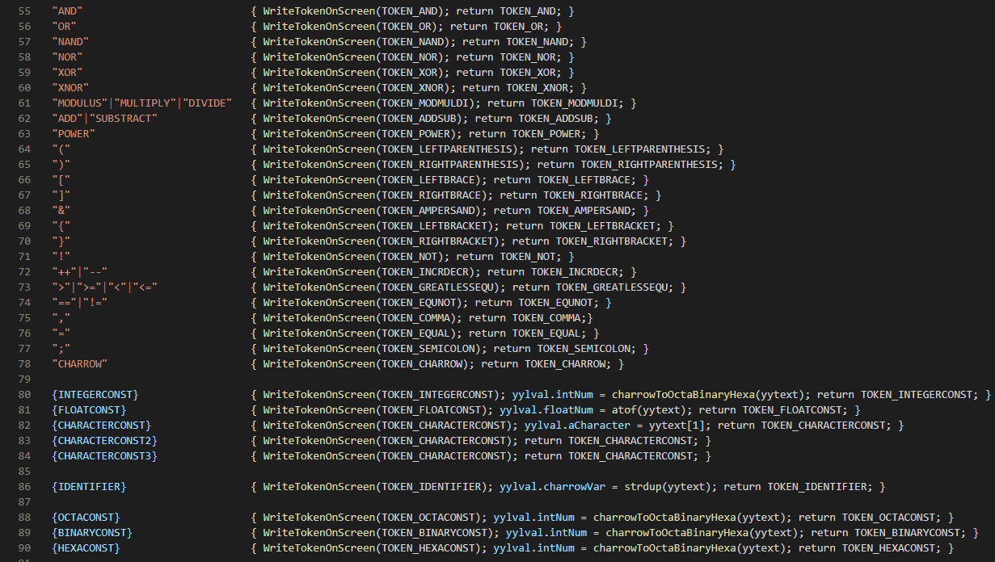
BitGate Lexical Analysis – “lexer.l” - Flex

Slide 8
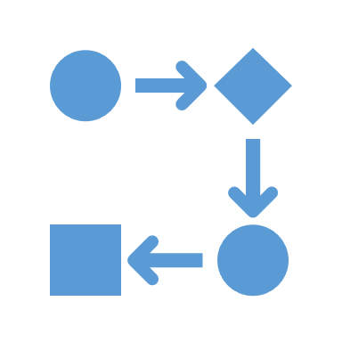
BitGate Syntax Analysis
In the Syntax Analysis of the BitGate language the 51 tokens were re-declared because the Syntax Analysis needs the type of each token. So, in the Syntax Analysis the tokens were declared with their type. Also, the most important in this phase is the implementation of the language's grammar.

Slide 9

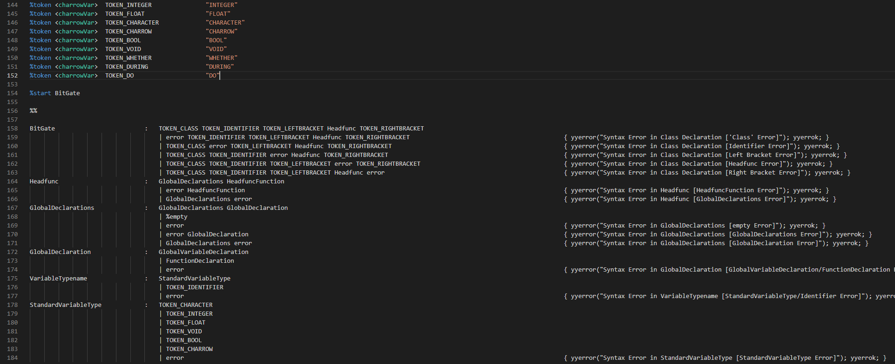
BitGate Syntax Analysis – “parser.y” - Bison

Slide 10

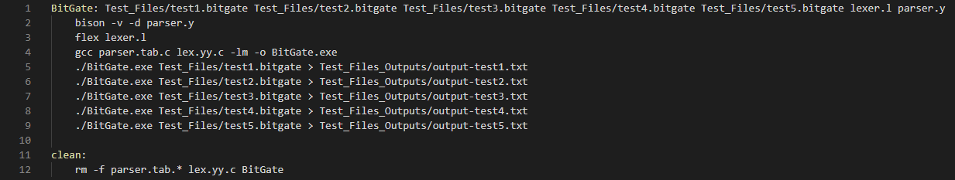
BitGate makefile - Make
makefile is a file that run all the commands that are needed to run the language–compiler with only one command in the terminal. The command is “make” and help us to save time.

Slide 11

Conclusion
In Conclusion, BitGate is a general-purpose language and consists of a “mix” of imperative and object-oriented language that implements an imperative and object-oriented paradigm. It is a “mix” of Object-Oriented Language, Functional Language and of an Algorithmic Language because it is based on code blocks and in classes. BitGate performs mathematical operations without symbols and performs logical expressions between numbers in decimal, binary, octal or hexadecimal form. It consists of two files, the file "lexer.l", in which is made the declaration and the match of tokens with static words or regular expressions, the file "parser.y", in which is made the declaration of language's grammar and of tokens with their type.

Slide 12


Thank You For Your Attention And Your Time!

